Slide 1
Binary Counters
Basic Structure
State of the counter
Modulus of the counter
In general an n-bit counter will have ‘n’ flip flops and 2^{n} states and divides the input frequency by 2^{n}. Hence it is a divide by 2^{n} counter
Notes:
Is a set of flip flops whose states change in response to pulses applied at the input to the counter.
Used to count pulses
Basic Structure:
In binary counter, the flip flops are interconnected such that their combined state at any time is the binary equivalent of the total number of pulses that have occurred up to that time.
state of the counter:
Each of the counts of the counter is called state of the counter
Modulus of the counter
The number of states through which the counter passes before returning to the starting state is called modulus of the counter
In general an n-bit counter will have ‘n’ flip flops and 2^{n} states and divides the input frequency by 2^{n}. Hence it is a divide by 2^{n} counter

Slide 2
Classification of counters
Synchronous and Asynchronous counters
Up counter or Down Counter
–ve edge triggered or +ve edge triggered

Slide 3
Ripple Counters
Asynchronous counters
Uses T topology
Also called as serial or series counters.
Notes:
T (Toggle ) topology:
It make use of Toggle property of the flip flop. Usually JK flip flops or T flip flops are used with J and K inputs or T input of the flip flops connected to 1.

Slide 4
Applications of counter
Used as frequency divider
In digital watches
To create time delays
To produce non-sequential binary counts
To generate pulse trains
To act as frequency counters

Slide 5
Shift Register
Registers are digital circuits which are used to store ‘n’ bits information in the same time.
built with D topology
All these flip flops are driven by a common clock and they are set or reset simultaneously.

Slide 6
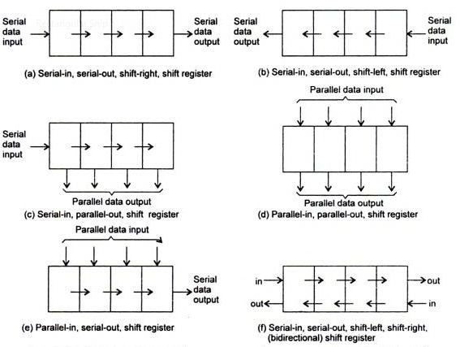
Shift Register
Data transmission in shift register

Slide 7
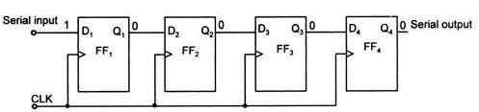
Serial In Serial Out Shift Register (SISO)
Data 1010 shifting in 4 bit SISO shift register if data entered from LSB
Clk Pulse | Q1 | Q2 | Q3 | Q4
Before the CLK | # | # | # | #
Clk 1 | 0 | # | # | #
Clk 2 | 1 | 0 | # | #
Clk 3 | 0 | 1 | 0 | #
Clk 4 | 1 | 0 | 1 | 0
Clk 5 | # | 1 | 0 | 1
Clk 6 | # | # | 1 | 0
Clk 7 | # | # | # | 1
Clk 8 | # | # | # | #
Data is loaded
MSB is available
# is any random data

Slide 8
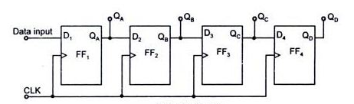
Serial In Parallel Out Shift Register (SIPO):
Parallel Outputs
Data 1010 shifting in 4 bit SIPO shift register if data entered from LSB
Clk Pulse | Q1 | Q2 | Q3 | Q4
Before the CLK | # | # | # | #
Clk 1 | 0 | # | # | #
Clk 2 | 1 | 0 | # | #
Clk 3 | 0 | 1 | 0 | #
Clk 4 | 1 | 0 | 1 | 0
Data is loaded and can be taken out

Slide 9
Applications of shift Registers
To store digital data during arithmetic and logical operations
Used in building Shift register counters such as simple ring counter and the Johnson counter

Slide 10
Summary
Flip flops are sequential circuits and can be constructed with NOR or NAND gates
Flip flop is an edge triggered , one bit memory device
Commonly used flip flops are – SR, D, JK and T flip flop
Flip flops are used in many applications like counters, shift registers

Slide 11
Summary
Counters can be Asynchronous or Synchronous , Up or down counters.
In general an n-bit counter will have ‘n’ flip flops and 2^{n} states and divides the input frequency by 2^{n}. Hence it is a divide by 2^{n} counter
Ripple counters are Asynchronous counters and constructed using T topology

Slide 12
Summary
Shift registers are built with D topology
All these flip flops are driven by a common clock and they are set or reset simultaneously.
Shift registers are classified depending on the data loading methods, shifting methods and data receiving methods

